Slide 1

Relational Model Mapping
Rules

Slide 2
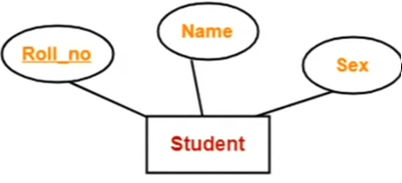
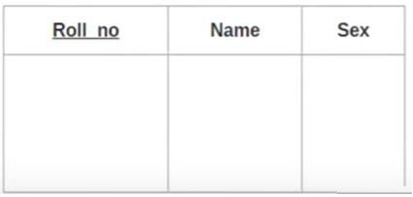
1.Mapping of Regular Entity with simple attributes
Student(Roll_no, Name, Sex )
Notes:
A strong entity with only simple attribute will require only one table in a relational model
Attributes of the table will be the attributes of the entity set
The primary key of the table will be the key attribute of the entity set.

Slide 3
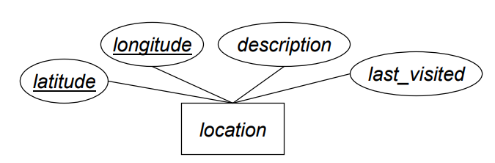
1.Mapping of Regular Entity with simple attributes
Notes:
A strong entity with only simple attribute will require only one table in a relational model
Attributes of the table will be the attributes of the entity set
The primary key of the table will be the key attribute of the entity set.

Slide 4
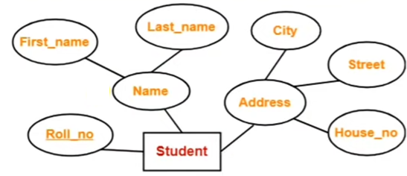
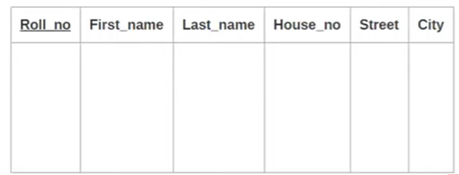
2.Mapping of Regular Entity with composite attributes
Student(Roll_no, First_name, Last_name, House_no, Street, City)
Notes:
A strong entity with composite attributes will require only one table in a relational model
While conversion simple attributes only are taken into account and the composite itself is ignored.

Slide 5
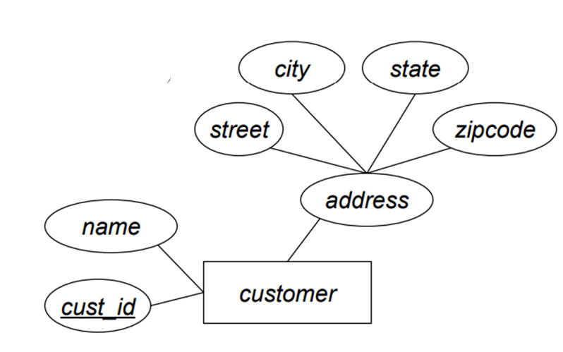
2. Mapping of Regular Entity with composite attributes
Notes:
A strong entity with composite attributes will require only one table in a relational model
While conversion simple attributes only are taken into account and the composite itself is ignored.

Slide 6
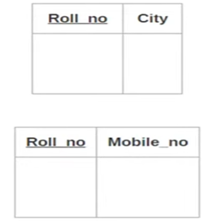

3. Mapping of Regular Entity with multi-valued attributes
Student(Roll_no, City)
ContactRoll_no, Mobile_no)
Notes:
A strong entity with multivalued attributes will require two tables in a relational model
While conversion simple attributes will comprise one table with the primary key
The second table will contain the primary key and all the multivalued attributes.
Other possible solution: Use several rows to represent a single entity
Persons(SSN, FirstName, LastName, Address, Birthdate)
(111111, John, 123 Main St, stamps)
(111111, John, 123 Main St, coins)
Problems with this solution:
Redundancy of the other attributes (never good)
Key of entity type no longer can be key of relation
Normalization is this decomposition transformation process we will study to help deal with this.

Slide 7
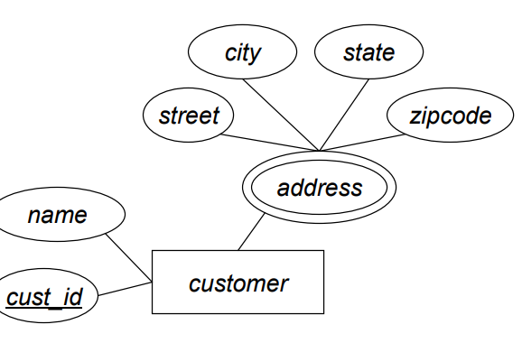
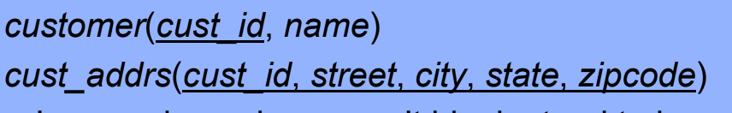
3. Mapping of Regular Entity with multi-valued attributes

Slide 8

4. Mapping of Regular Entity with derived attributes
Coded separately in SQL as a view. They are not an attribute in a basic relation table.
Student(Roll_no, Date of Birth)
Notes:
Note on attributes:
not all attributes in the relational model are attributes on an entity; we may have attributes that are establishing relationships.

Slide 9
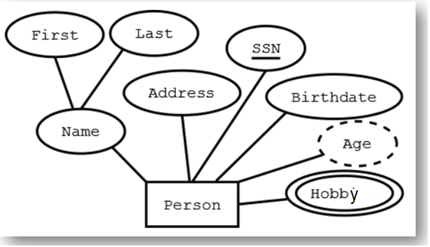
4. Mapping of Regular Entity with derived attributes
Coded separately in SQL as a view. They are not an attribute in a basic relation table.
Person(SSN, First, Last, Address, Birthdate)
Per_Hobby(SSN, Hobby)
Notes:
Note on attributes:
not all attributes in the relational model are attributes on an entity; we may have attributes that are establishing relationships.

Slide 10
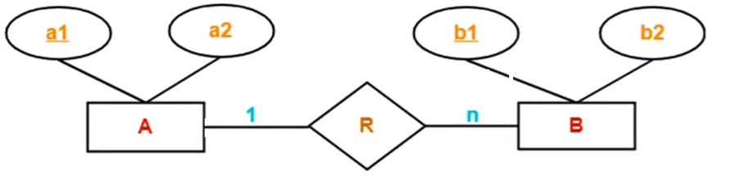
5a. Mapping of Binary 1:m relationship
Partial
Participation from both sides
A(a1,a2)
BR(b1,b2,a1)
a1 may be NULL in BR

Slide 11
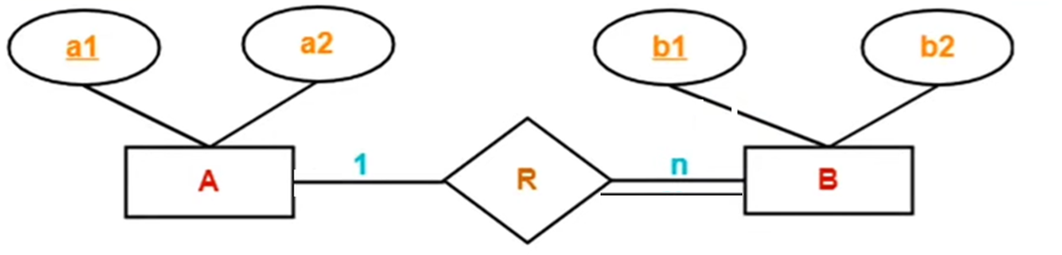
5b. Mapping of Binary 1:m relationship
Total
Participation from one side
A(a1,a2)
BR(b1,b2,a1)
a1 may not be NULL in BR

Slide 12
5b. Mapping of Binary 1:m relationship
OrderID
PersonId
Person
Order
Places
1
M
Name
Name
Time
Person(PersonID, Name,)
Order(OrderID, Name, Time, PersonID)
PersonID may not be NULL
Notes:
1-MANY RELATIONSHIP: the primary key attributes of the "1" relation becomes the foreign key attributes of the "many" relation

Slide 13
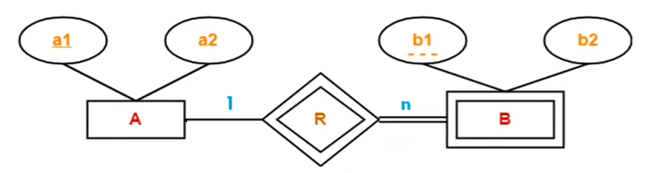
5c. Mapping of Weak Entity
Total
Participation from one side
A(a1,a2)
BR(a1,b1,b2)
a1 may not be NULL
Notes:
Weak entity set always appears in association with identifying relationship with total participation and there is always a one-many felationship from identifying entity set to weak entity set

Slide 14
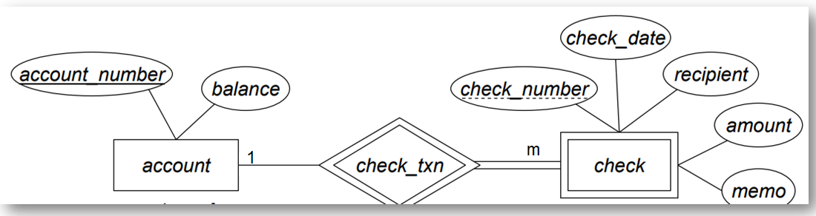

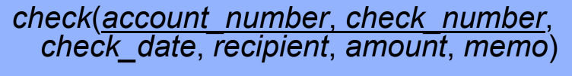
5c. Mapping of Weak Entity
Total
Participation from one side
account_number may not be NULL

Slide 15
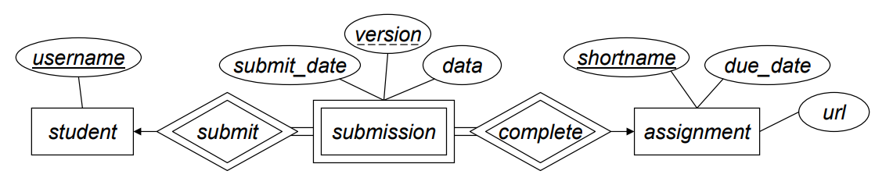
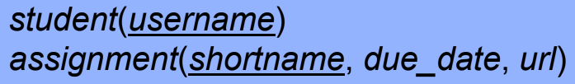

5c. Mapping of Weak Entity
M
M

Slide 16
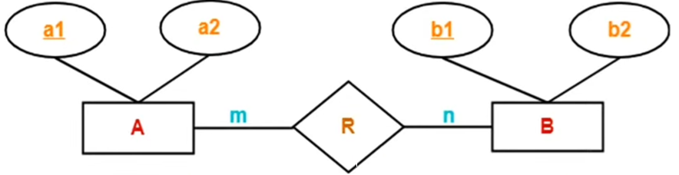
6a. Mapping of Binary m:m relationship
A(a1,a2)
B(,b1,b2)
R(a1,b1)
Notes:
M:M relationship three tables will be required

Slide 17
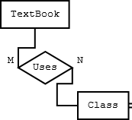
6. Mapping of Binary m:m relationship
Textbook(ISBN, Title, Author, Copyright, Edition, Price) Class(ClassNo, Name, Room, Days, Time) Uses(ISBN, ClassNo)

Slide 18
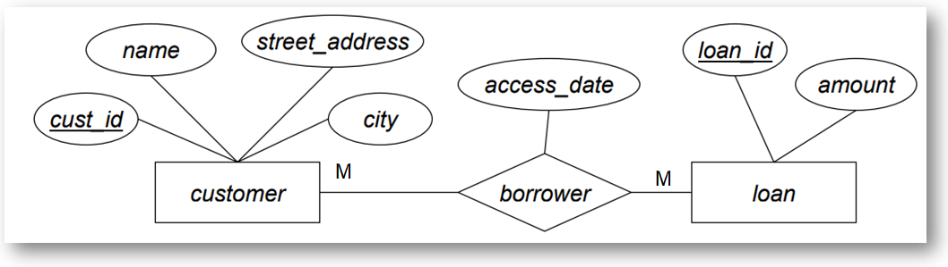
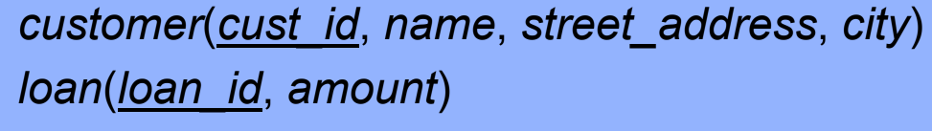
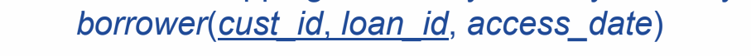
6. Mapping of Binary m:m relationship

Slide 19
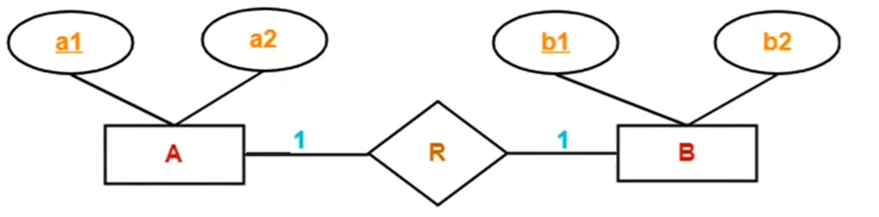

7a. Mapping of Binary 1:1 relationship with partial participation from both sides
AR(a1,a2,b1)
B(b1,b2) OR
A(a1,a2)
BR(b1,b2,a1)
Partial
Participation from both sides
may be NULL
Notes:
One-to-one relationship two tables will be required
Either combine R with A or B

Slide 20
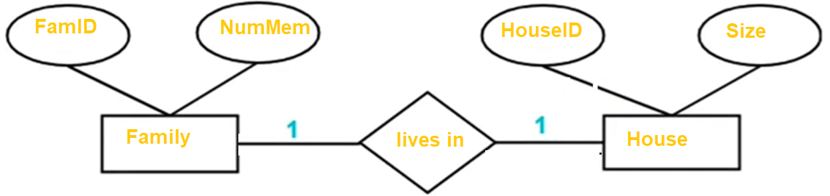
7a. Mapping of Binary 1:1 relationship with partial participation from both sides
Family(FamID,NumMem, HouseID)
House(HouseID,Size) OR
Family(FamID, NumMem)
House(HouseID, Size, FamID)
Partial
Participation from both sides
may be NULL
Notes:
One-to-one relationship two tables will be required
Either combine R with A or B

Slide 21
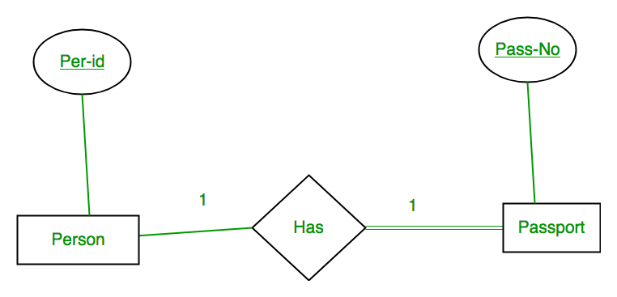
7b. Mapping of binary 1:1 relationships with total participation from one side
Person(Per-id)
Passport(Pass-No, Per-id)
may not be NULL

Slide 22
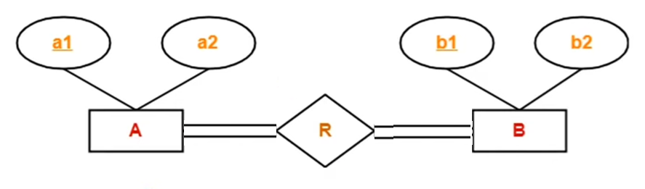
7c. Mapping of binary 1:1 relationships with total participation from both sides
ARB (a1, b1, a2, b2)
Notes:
If there is a key constraint from both the sides of an entity set with total participation, then that binary relationship is represented using only single table

Slide 23
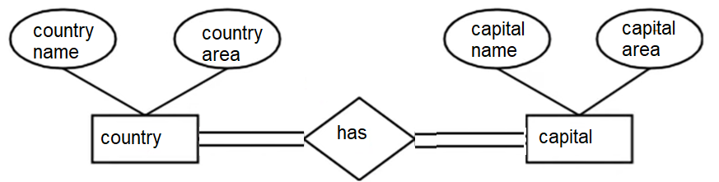
7c. Mapping of binary 1:1 relationships with total participation from both sides
CountryCapital(country_name, capital_name, country_area, capital_area)
Notes:
If there is a key constraint from both the sides of an entity set with total participation, then that binary relationship is represented using only single table

Slide 24
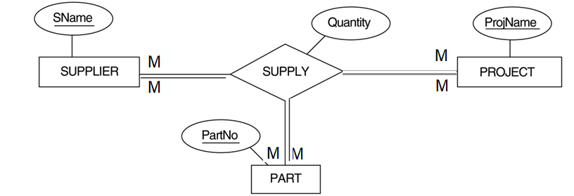
8. Mapping of n-ary relationships
Supplier (Sname, …)
Project (ProjName, …)
Part(PartNo, …)
Supply (Sname, ProjName, PartNo, Quantity)

Slide 25
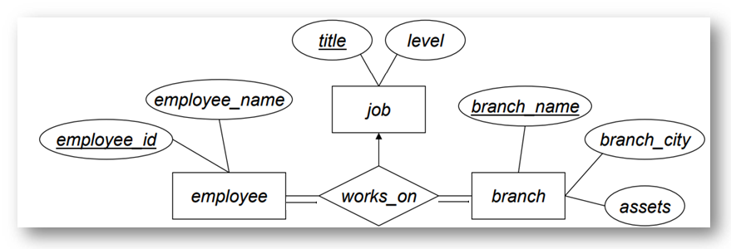
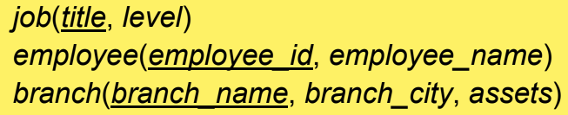
8. Mapping of n-ary relationships
1
M
M
M
M
1

Slide 26
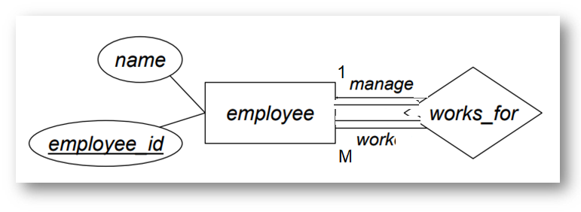

9. Mapping of unary (recursive) relationships
manager_id: NOT NULL

